Slide 1
Golden Cross Resources COPPER HILL PORPHYRY Cu-Au DEPOSITS MINES & WINES TOUR Coppervale – Wednesday 11th September 2013
Kim Stanton-Cook
GCR Managing Director

Slide 2
Acknowledgments to
David Timms, Chris Torrey, Robin Hee, Paul Burrell, Bret Ferris, Glenn Coianiz, Anne Eastwood,
Chris Johnston, Natasha Jacobs, Pete White, Vladimir David, Rob Harley, Jonathan Hoye,
Glenn Diemar, Eath Chhun, Steve Collins,
Bob White, Dane Burkett, Neil Rutherford,
Greg Corbett, Paul Ashley, Colin Brooks,
Alan Chivas, Mike Erceg and many more

Slide 3
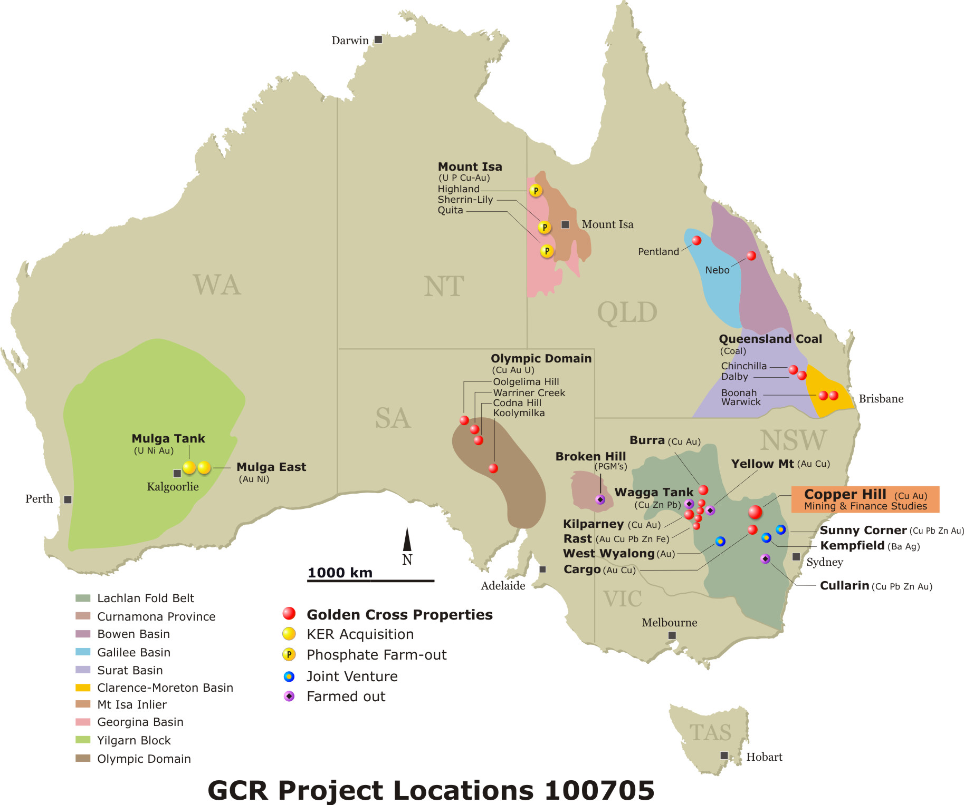

Slide 4
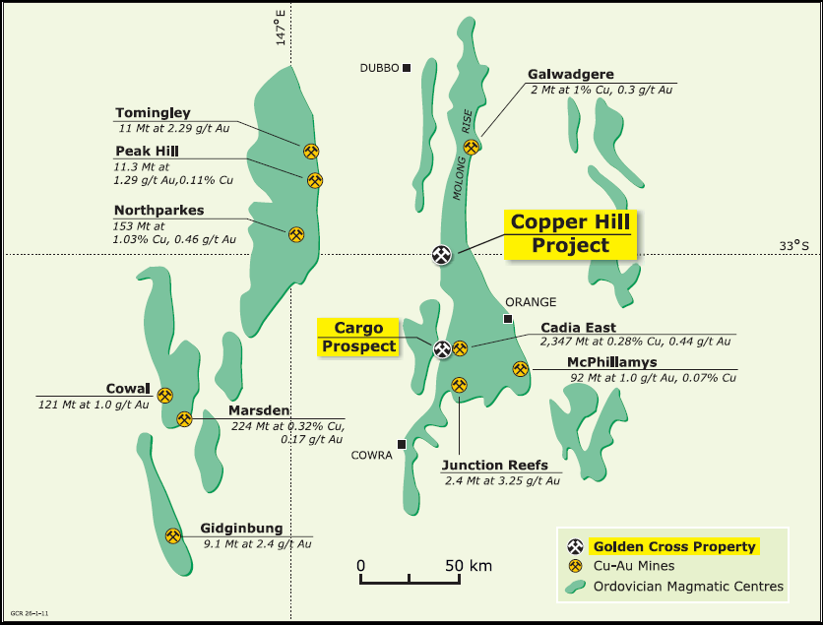
Copper Hill: Regional Address
153 Mt @ 0.31% Cu & 0.27g/t Au

Slide 5
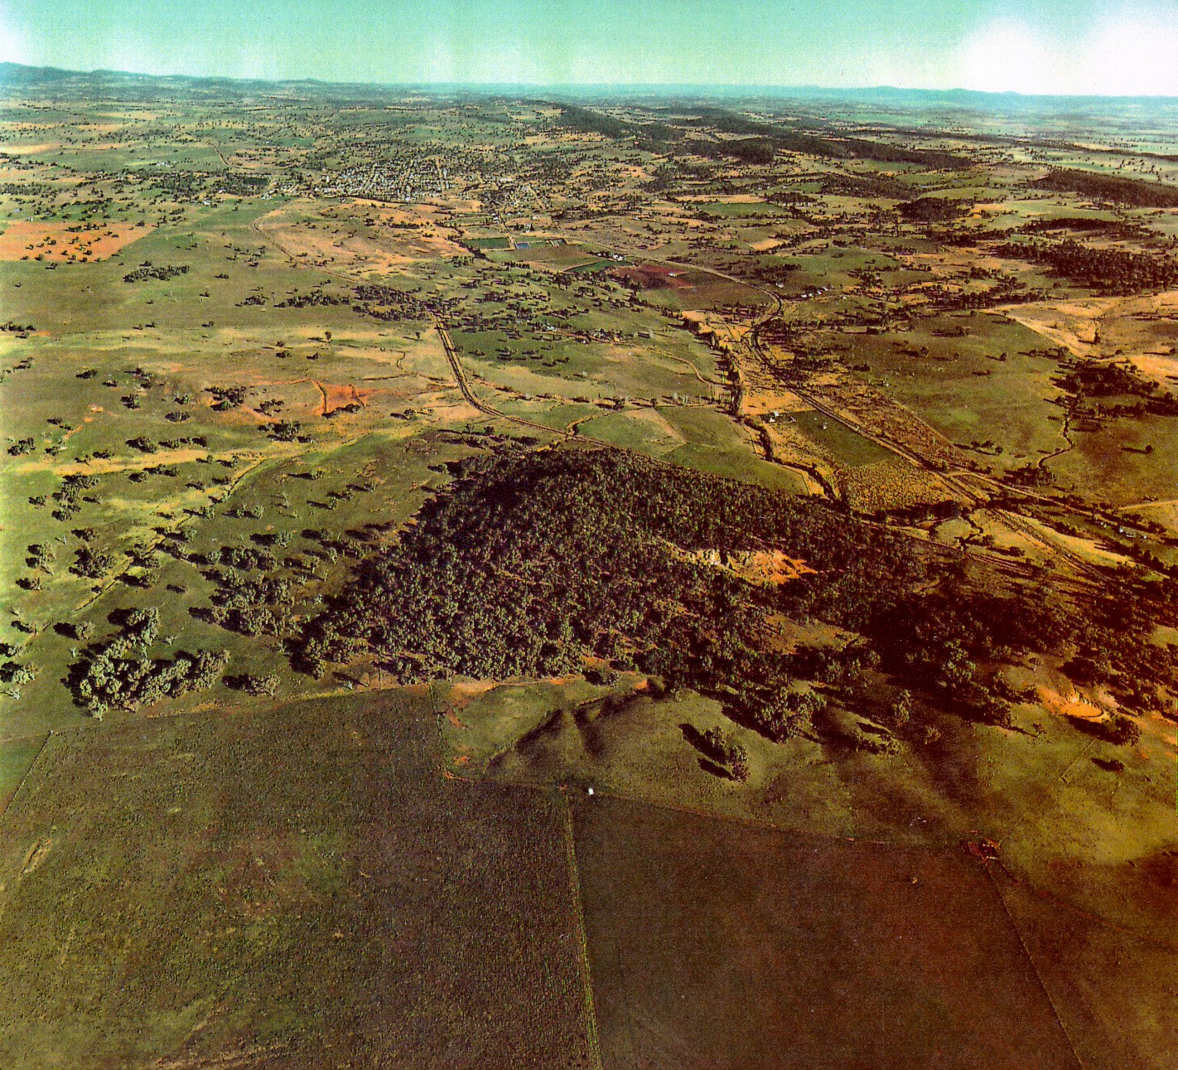
Cadia 45 km to southeast
Northparkes 80 km to northwest
Molong township
Wattle Hill
Copper Hill
Boundary
Buckley’s Hill
Copper Hill, aerial view looking south
Notes:
Copper Hill is very well placed in regard to infrastructure; it lies 5 km north of Molong (pop. 2,000), and the towns of Orange (pop. 40,000) and Wellington (pop. 10,000) lie 40 km southeast and 60 km north respectively. A large percentage of the workforce is likely to come from these and other nearby towns and from rural properties in the district.
The Mitchell Highway is a primary highway from Orange which passes beside Copper Hill before continuing north to Wellington and Dubbo. Driving time from Sydney to Copper Hill is less than four hours.
The former Orange to Dubbo railway line now terminates on the western side of Copper Hill. The track is 80 lb, suitable for low-speed, high axle-weight use with in-bound construction materials and outbound concentrate trucks able to join the main Australian east-west rail line at Molong.
A 132kv power sub-station lies on the eastern outskirts of Molong, only 4.5 km from Copper Hill. The transmission grid in the region currently has available capacity.

Slide 6
Copper Hill - Basics
Resources Block Model estimated by Lewis Mineral Resource Consulting: 153 million tonnes at 0.32% Cu & 0.28g/t Au containing 0.49 million tonnes copper and 1.33 million ounces of gold.
Copper Hill Igneous Complex of late-Ordovician calc-alkaline, multi-phase dacite-tonalite intrusions within a north-south trending sequence of Ordovician basaltic andesite lavas

Slide 7
COPPER HILL HISTORY
Discovered and mined around 1845 – 60m deep shafts, cross-cuts and unsuccessful reverberartory furnace
1850 – 1966 sporadic small scale mining
1966-67 - exploration for porphyry copper (Anaconda)
1970s – exploration for copper (Amax Australia, Le Nickel, NSW DMR)
1980s – exploration for copper and/or gold (BHP, Homestake, Cyprus Gold)
1990s – exploration for copper-gold (Amoco-Cyprus, Newcrest and MIM)
2000 to 2007 – exploration for copper – gold (MIM and GCR)
Consolidation of EL’s into a single merged tenement (EL 6391) in early 2005, all exploration has been undertaken 100% by GCR.

Slide 8
Copper Hill – Work Completed
Airborne magnetic & radiometric surveys
Induced Polarisation surveys
Geochemical surveys
Geological mapping
Drilling – logging (lithologies, mineralisation, alteration, structure) assigning domains
Resource calculations
Mining studies including pre-feasibility

Slide 9
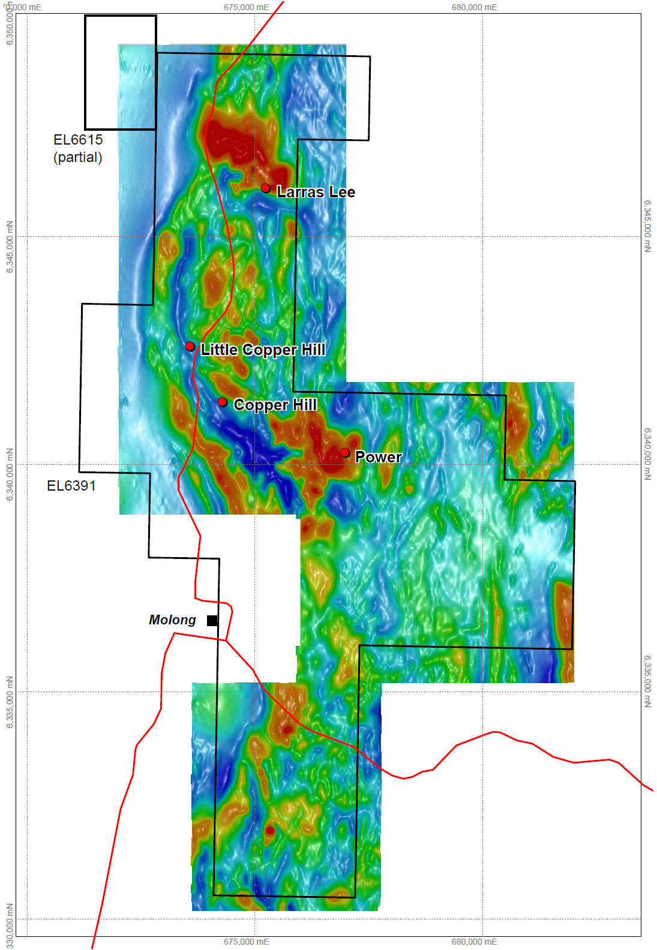
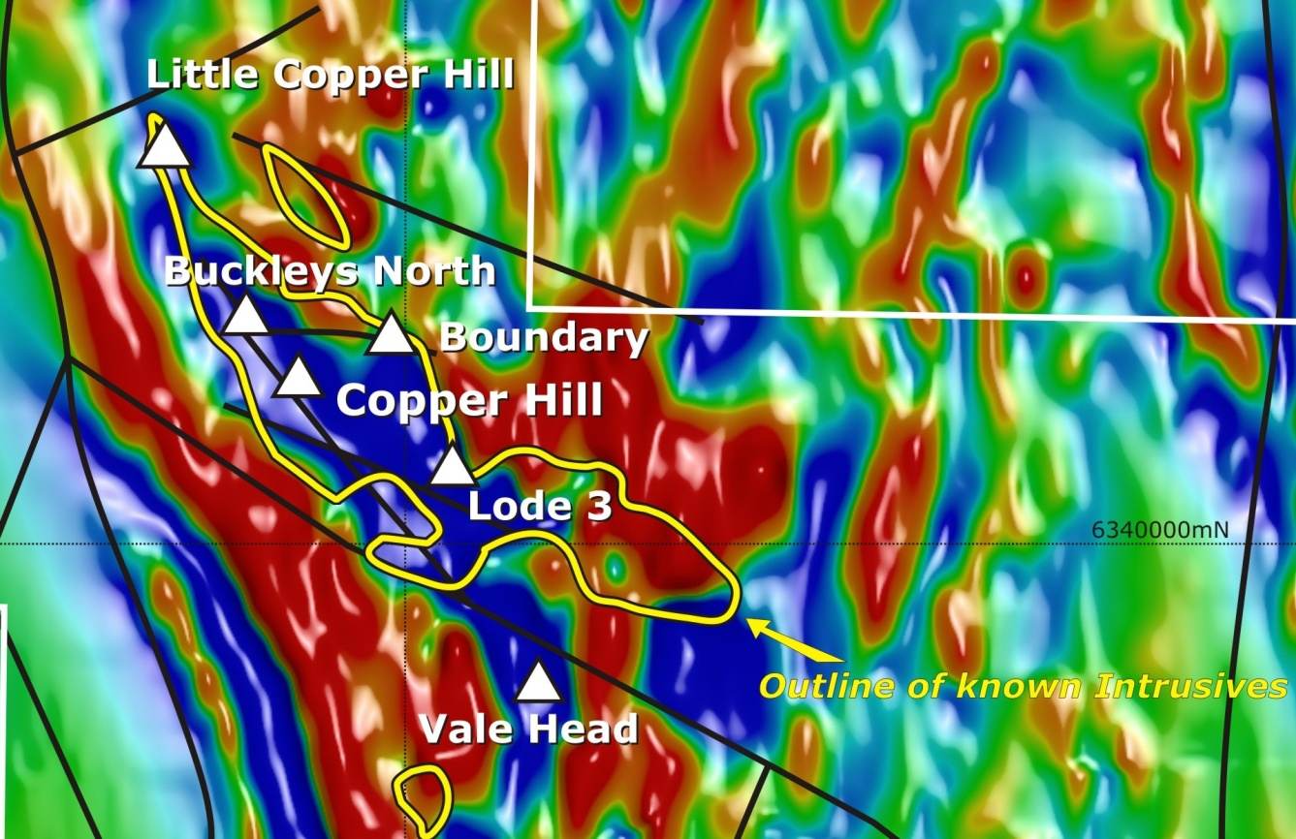
Copper Hill Magnetics

Slide 10
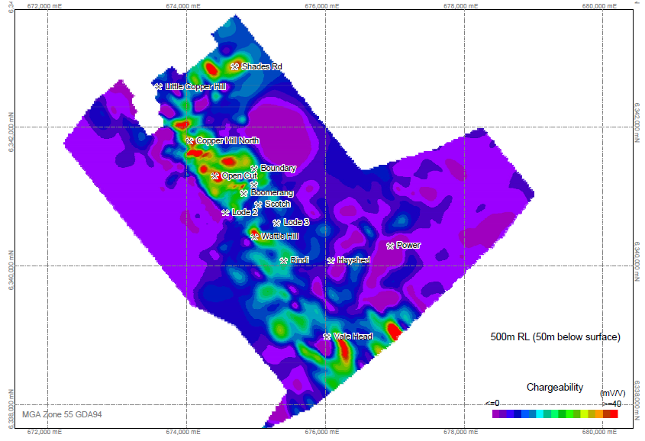
Copper Hill IP - Chargeability
2km

Slide 11
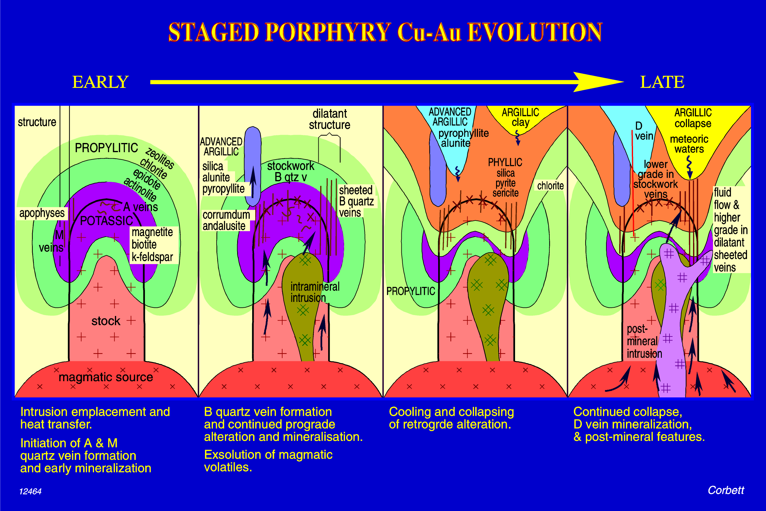
Greg Corbett’s Evolving Porphyries

Slide 12
Vein styles - adapted from Greg Corbett’s Copper Hill Report
Various veins are characterised as different styles described in the geological literature for porphyry Cu-Au deposits as:
M veins: laminated veins, crystalline quartz with magnetite separating quartz laminations and within the quartz along with pyrite, chalcopyrite and bornite. Interpreted to have formed late in the cooling history of intrusions in association with potassic alteration. They are most common close to intrusion margins and not within adjacent wall rocks.
B veins: random stockwork or linear sheeted veins characterised by central inwardly terminated comb quartz or crystalline quartz. Alteration selvages may be either prograde (Kfeldspar) or retrograde (sericite). Importantly the central open vein portions are commonly filled with later sulphides such as pyrite or chalcopyrite, and gangue such as carbonate.
C veins are regarded as the massive sulphide (pyrite, chalcopyrite and lesser bornite) bearing fracture veins which typically overprint M and B veins or locally occur without quartz overprinting earlier alteration.

Slide 13
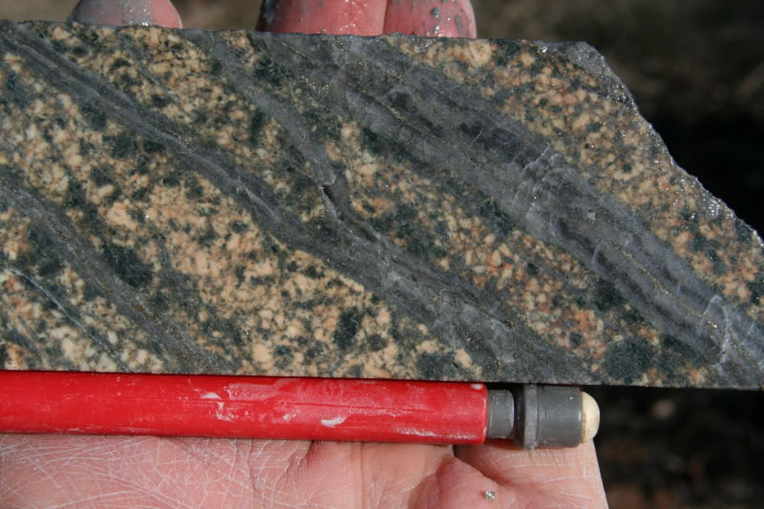
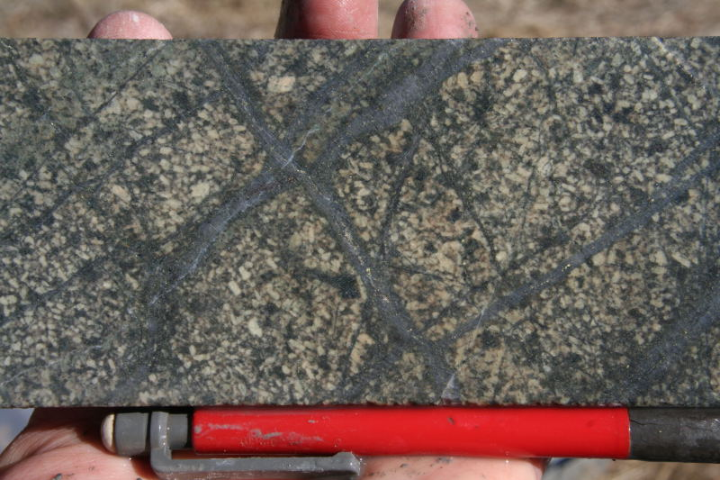
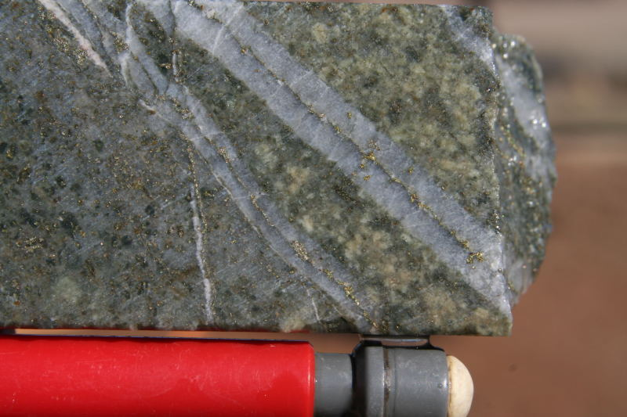
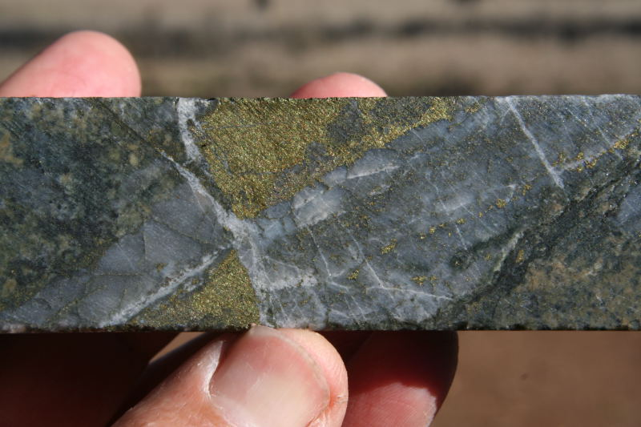
Greg Corbett photographs
Sheeted laminated quartz-magnetite-sulphide (M style) veins within intrusion F - DDH107, 257 m.
Stockwork B veins in intrusion F
DDH 107 214m
Sheeted B veins in sericite altered intrusion F. Note the central terminations with sulphide fill - DDH 64, 132m.
C vein style sulphides overprinting laminated quartz vein - DDH 64 139m

Slide 14
Vein style - from Greg Corbett’s Copper Hill Report
C veins are regarded as the massive sulphide (pyrite, chalcopyrite and lesser bornite) bearing fracture veins which typically overprint M and B veins or locally occur without quartz overprinting earlier alteration.
D veins represent veins developed in more marginal settings, varying to epithermal crustal levels, to the source intrusion typically within structures and comprise both high and low sulphidation end members. The low sulphidation end members are dominated by coarse cubic pyrite and lesser chalcopyrite where they conform to the quartz-sulphide Au + Cu mineralisation of Corbett and Leach (1998), and pass laterally to more marginal or later mineral assemblages which correspond to the carbonate-base metal Au mineralisation style of Corbett and Leach (1998).

Slide 15
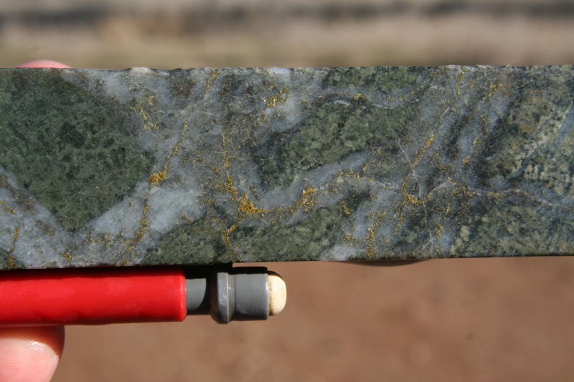
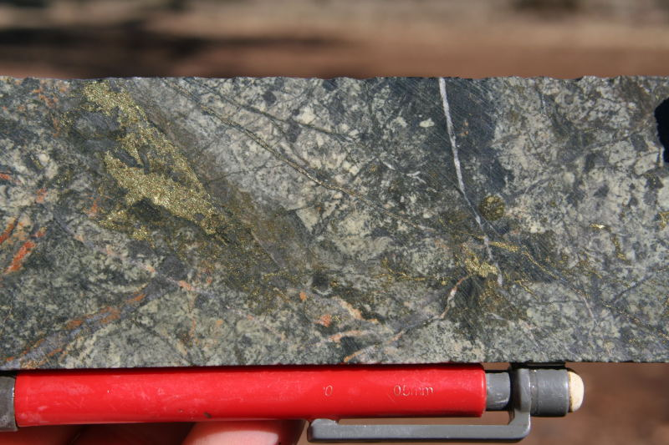
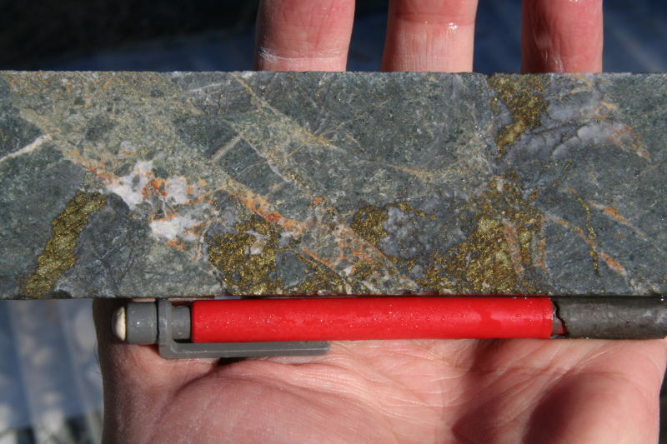
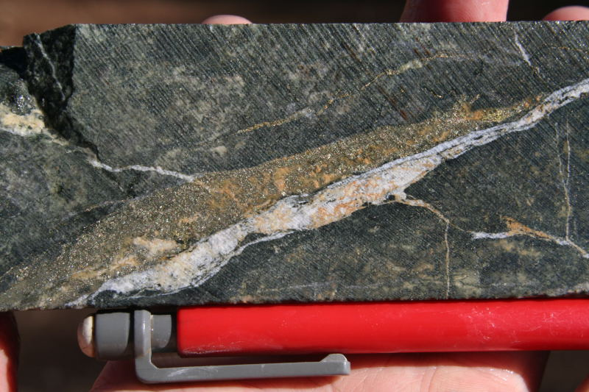
Later sulphides overprint laminated and B veins – DDH 64 130m
Early chlorite-magnetite alteration cut by later sulphides of a C vein style – DDH 74 248m.
Sulphide fill breccia of a C vein type- DDH 107 232m.
Pyrite-rich D vein with later carbonate - DDH 74 245m

Slide 16
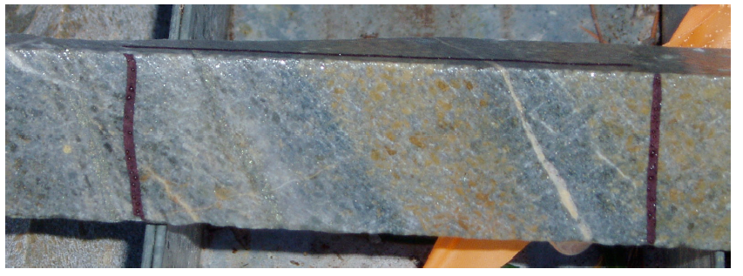
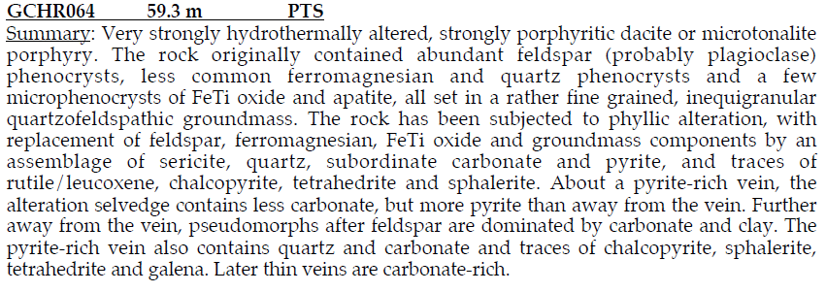
Paul Ashley’s Petrographic Studies

Slide 17
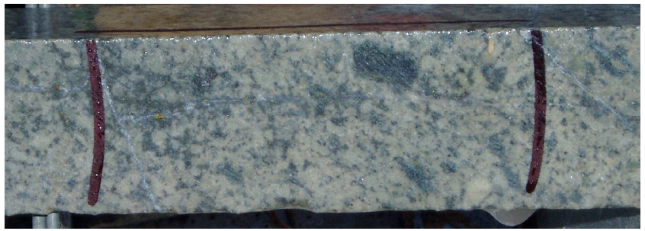

Slide 18
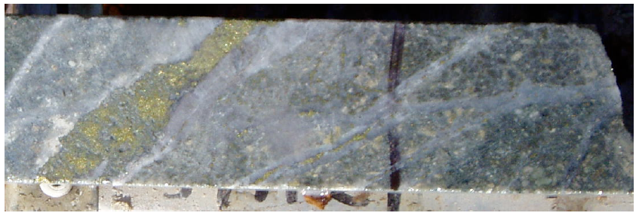

Slide 19
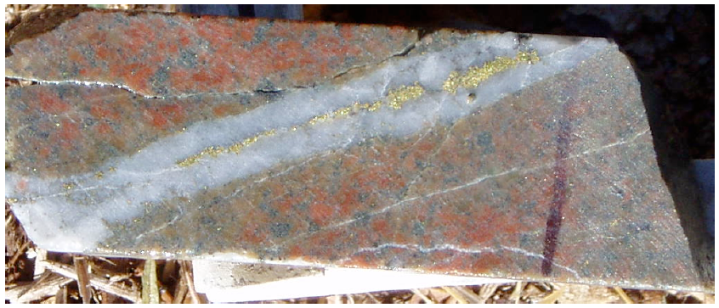

Slide 21
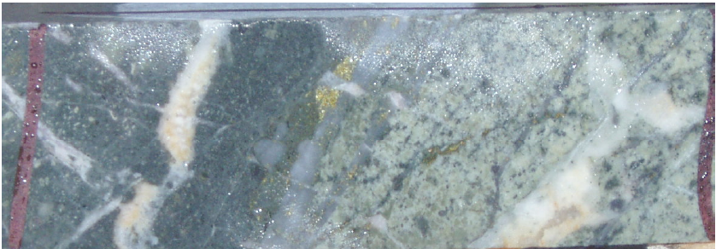
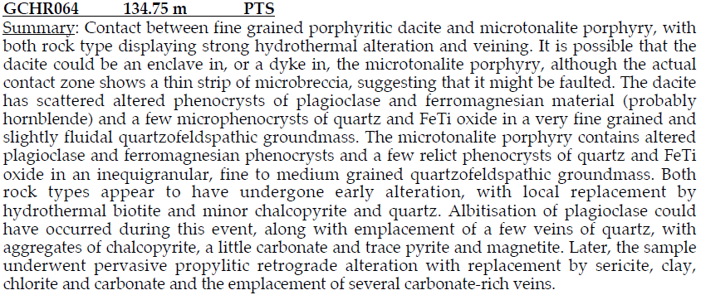

Slide 22
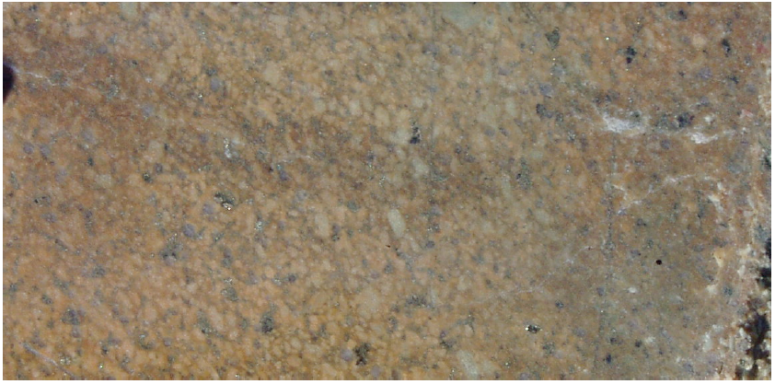

Slide 25
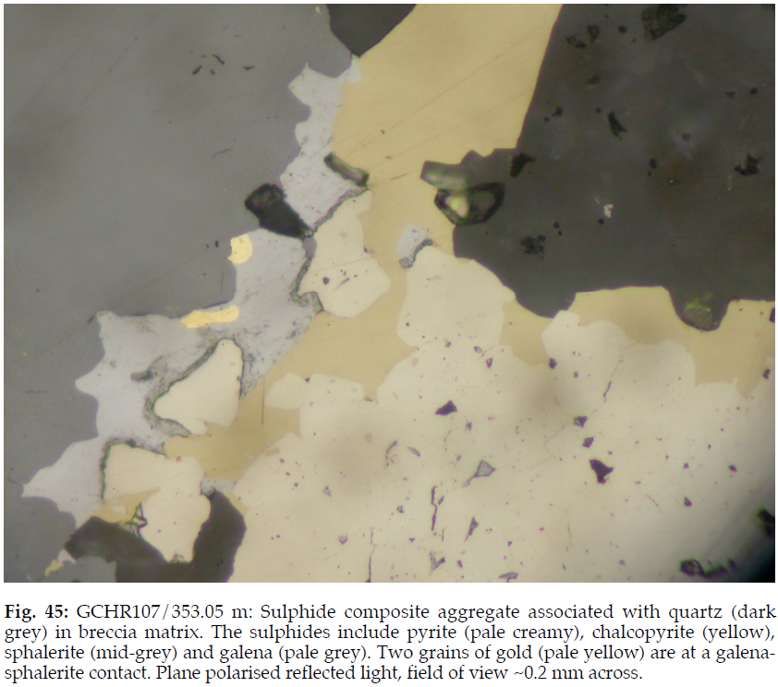

Slide 26
Copper Hill Geological/Mineral/Alteration DOMAINS
Mineralising Tonalite Porphyry - mineraliser domain
Position – central top of area enclosed by pit shell, directly below the supergene zone.
Rock host – mainly MTP, some andesitic volcanics and TP dykes
Mineralisation style - dense to moderately dense veining – ‘M’ veins and ‘B’ veins + sulphide disseminations, mostly cpy.
Alteration- sericite-magnetite-chlorite (SCM) and sericite-chlorite-carbonate (SCC), typically.
M veins – quartz-mt-cpy-bn-(py) and gold
B veins – quartz – cpy – py- (bn, carbonate), characterised by a central zone of sulphide within the veins
Estimated volume of total ore tonnage– 31%
Unassigned LG primary
Position – peripheral to the MTP mineraliser and Crowded Tonalite Porphyry/carapace domains.
Consistent low grade copper-gold mineralisation, vein hosted and disseminated,
within the pit shell but peripheral to the higher grade MTP-mineraliser domain.
Host rock not well defined but usually MTP or CTP/TP. Alteration – SCC, combinations of chlorite, sericite, carbonate, epidote, albite (propylitic)
Estimated volume of total ore tonnage– 31%

Slide 27
CTP/carapace domain
Position – below the MTP-mineraliser domain
Rock host – mainly CTP, some MTP, TP dykes and andesitic volcanic
Mineralisation style - moderately dense to sparse veining – ‘B’ veins, ‘C’ veins and ‘D’ veins. Disseminated cpy and py also.
C veins – white to pink carbonate (Mn-bearing?) carbonate veins, commonly bearing some or all of cpy, sphal, gal, bn, py and gold. Base metal carbonate veins. These veins are commonly triangular in shape, as if infilling spaces formed by brecciation.
D veins – very late-stage veining – calcite, siderite or laumontite (gypsum, anhydrite at depth). These are unmineralised.
Estimated volume of total ore tonnage – 20%
Argillic domain
Position – near-surface on the western side of the deposit, and in small patches in the Unassigned LG domain.
The least well defined zone in a sparsely drill-tested part of the deposit.
Rock host – Undifferentiated tonalite porphyry, CTP, MTP.
Mineralisation style – mainly disseminated py and cpy with some B vein hosted mineralisation.
This zone is characterised by its alteration style – white clay – sericite – minor silicification patches and chlorite, bordering on phyllic alteration.
Estimated volume of total ore tonnage – 6%

Slide 28
Mineralised breccia domain
To date, only intersected at Wattle Hill. Estimated volume of total ore tonnage ~1%.
Mixed tonalite porphyry/andesitic volcanic domain
Position – north-western part of the deposit. A discontinuous domain from 5200N to 6200N (local grid). Typified by mineralisation in GCHR298 and 319, where many small intrusions of tonalite are present in andesitic volcanic host rocks. This domain includes contact zone hydrothermally/magmatically brecciated andesite with tonalite porphyry clasts.
The mineralisation is ‘B’, ‘C’ and ‘D’ vein and disseminated pyrite and chalcopyrite. The alteration is variable reddening-ser-si-carb-chl.
Estimated volume of total ore tonnage = 8%
Mineralised waste
Samples of core judged to be below ore grade.
Barren intrusions/ QTP
Very barren, late, unaltered quartz tonalite porphyry dykes/intrusions. Average copper grade – 60ppm, average gold grade - <0.01g/t. This type of intrusion produces high grade gold and copper mineralisation in host rock around its contacts, probably by remobilisation into quartz veins.
Barren Zone/low-grade core
The ‘Barren Zone is a poorly drill-defined zone in the south-eastern part of the Copper Hill area. The gold and copper grades are sub-ore but above background levels, making it more mineralised than the Barren intrusion/QTP domain. The host rock is probably Crowded Tonalite Porphyry.

Slide 29
NEW ZONES
Buckley’s Hill Extensions
&
Wattle Hill Infill & Deeps

Slide 30
COPPER HILL DRILLING 2010 and into 2011
Buckley’s Hill Extensions
+200m wide near surface +480m wide at depth
Drill intervals of:
486m @ 0.33% Cu
283m @ 0.23%Cu
with
66m @ 0.6% Cu
108m @ 0.43% Cu
+ gold credits
OPEN ALONG STRIKE & DEPTH

Slide 31
200 metres
Buckley’s Hill, Section 6150N
Big & expanding zone indicated
Copper and gold grades remain elevated and above average.
Substantial extensions indicated along strike to the northwest
Vector to higher grade mineralisation at depth?
Success here will all contribute positively to the next resource estimate.

Slide 32
Open, next section to be drilled
6250N
6200N
283m @ 0.23% Cu
313m @ 0.25% Cu
6150N
6100N
6050N
190m @ 0.42% Cu
106m @0.31% Cu
(Shallow holes)
6000N
486 m @ 0.33% Cu

Slide 33
CASE STUDY – Copper Hill 6 years of effort
Scoping Studies
Pre-feasibility studies
Several alternative strategies to make Copper Hill work…..
Can a project be ‘forced’ into production?

Slide 34
May 2006 Resource Estimate
Copper Hill is a low grade deposit with all that entails in trying to develop it

Slide 35
July 2006 Copper Hill Scoping Study Commenced
SRK Consulting (SRK) commenced a Scoping Study for Copper Hill.
5 million tonnes per annum production rate, initial head grades for Year 1 would be 0.60% copper and 0.62 g/t gold and, in Year 5, 0.45% copper and 0.44 g/t gold.
Year 1 production could be 25,500 tonnes of copper and 80,000 ounces of gold (assuming 85% recoveries) with
Year 5 production of around 22,500 tonnes of copper and 70,000 ounces of gold.
By Year 10, head grades would be 0.36% copper and 0.37 g/t gold yielding 18,000 tonnes of copper and 58,000 ounces of gold annually.

Slide 36
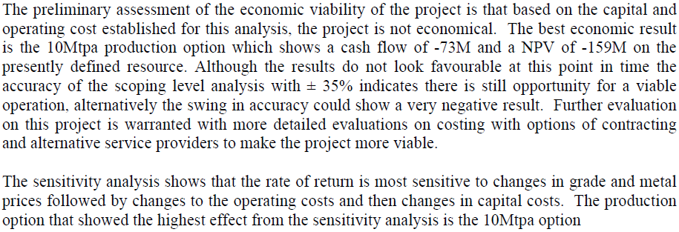
SRK Scoping Study January 2007 Conclusions from the Executive Summary

Slide 37
COPPER HILL: New Pit Optimisations SETTING THE TRACK TO PRODUCTION
INITIAL PROJECTIONS:
Discounted Cash Flow of $360M (10% discount rate) after $420 million capex deducted
8 million tonnes per annum to mill
19.5 year mine life
Production of over 335,000 tonnes copper, 1.1 million ounces gold
3.3 million tonnes sulphur for 9 million tonnes sulphuric acid
Capital cost estimate $420 million with potential for reduction
Environmental benefits with all elements extracted, value added: copper metal, gold bullion, sulphur to acid and iron to feedstock.

Slide 38
November 2009 SETTING THE TRACK TO PRODUCTION
Mine-crush-grind-flotation at Copper Hill producing total sulphide concentrate for loading to existing on-site rail-head
Rail concentrate to purpose-built roaster–acid plant–SX-EW–CIL in South Australia

Slide 39
November 2009 Unbounded optimism (…..delusion….?)
Development costs of about $310 million estimated -open pit mine - conventional crush-grind-float technology - ore throughput of 8 million tonnes per annum.
Additional $110 million is estimated to build a sulphide roaster, sulphuric acid recovery plant with copper metal recovery using SX-EW and gold to bullion by CIL.
To recover annually, on average, about 17,000 tonnes of copper, about 55,000 ounces of gold and over 450,000 tonnes of sulphuric acid for almost twenty years.

Slide 40
November 2009 – Inputs & Limits
The pit optimisation modelling used previous mining studies, costs from similar operations and in-house data gathering.
Further inputs: Pit wall slope 45°, strip ratio range 0.5 to 0.2:1, mining costs $1.17 to $1.77/tonne, processing cost to concentrate $7.40/tonne, concentrate rail freight $32/tonne (10% moisture content) with treatment and marketing costs estimated at $112/dry metric tonne concentrate.
The project required current metal prices to be sustained in the long term.
The capital cost estimates for process plant and infrastructure for an 8Mtpa operation had to be achieved or bettered
For the roaster, joint ventures with other sulphide suppliers were considered for sharing construction and operating costs.
Acid sales to BHPB-OD were critical to the project’s success.

Slide 41
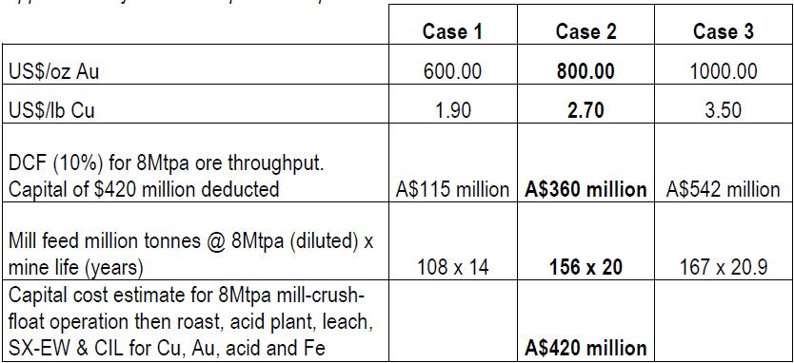
November 2009, Resources & Conceptual Optimised Pit Parameters
Fx 0.75 | Fx 0.85 | Fx 0.95

Slide 42
2009 Copper Hill Project – Potential Production
Conventional Concentrate Approach
8 million tonnes per annum throughput
over a 12-year mine life
to produce in total recoverable
260,000 tonnes of copper and
400,000 to 500,000 ounces of gold
Assuming 85% Cu and 55% Au recovery
Notes:
At an 8Mtpa operation at Case 2 metal prices, sufficient material could be treated to produce, in aggregate, about 240,000 tonnes of copper in concentrate with 400,000 to 500,000 ounces of recovered gold over a twelve year mine life.
CMS’s capital cost estimate of $330 million indicates that an NPV of about $270 million is possible using Case 2 metal prices and treating 8 million tonnes of ore per annum over a 12-year mine life. These prices are above long term averages but below current spot. For potential participants seeking medium term secure supply the mid-range economic model may be attractive.

Slide 43
But this approach did not maximise the value of the elements present at Copper Hill.
Copper
Gold
Sulphur
Iron
Notes:
At an 8Mtpa operation at Case 2 metal prices, sufficient material could be treated to produce, in aggregate, about 240,000 tonnes of copper in concentrate with 400,000 to 500,000 ounces of recovered gold over a twelve year mine life.
CMS’s capital cost estimate of $330 million indicates that an NPV of about $270 million is possible using Case 2 metal prices and treating 8 million tonnes of ore per annum over a 12-year mine life. These prices are above long term averages but below current spot. For potential participants seeking medium term secure supply the mid-range economic model may be attractive.

Slide 44
2009 Process Concept
How to maximise returns from Copper Hill
Conventional Circuit comprising crusher, stockpile, reclaim, SAG mill, ball mill, rougher, cleaner float with regrind and pyrite circuit,
Concentrate thickening, filtration, storage, loading, tailings thickening and dam and concentrate storage.
Rail sulphide concentrate to Port Pirie
Roaster, roast gas handling and acid plant,
Calcine quench and thickener, calcine acid leach for copper, thickening and filtration, lime neutralisation,
Gold CIL, and smelt to bullion,
Copper sulphate crystallisation or SX followed by electro-winning + tank house with copper cathode handling.
Granulate and bag iron oxide calcine for sale
Notes:
Metallurgical test work by Metcon Laboratories has advanced using average grade samples from 16 core holes widely spread throughout the deposit. Copper recoveries of about 85% are achievable but, in order to create a +25% copper concentrate, gold-bearing pyrite is removed as tails thus reducing gold recoveries to about 50%. Gold recoveries may be improved with the addition of a CIL recovery circuit to treat the pyrite floated off.
The Copper Hill bulk mineralisation has a low ball-mill bond work index of 17.3 which is expected to reduce residence time in the mill yielding savings in processing costs.
Copper Hill copper concentrate contains no deleterious elements.
Maximising the return from the existing resource may be possible if all sulphides can be floated, roasted and cathode copper produced by SX/EW and gold bullion by CIL. Roaster SO2 will be captured to produce H2SO4 for leaching and sale and granulated calcine (Fe2O3) should find a ready market

Slide 45
Copper Hill Project – Additional Revenue
Recover
SO2 for sulphuric acid production
&
After Cu and Au leaching, granulate the Fe2O3 calcine for sale.
ADDED VALUE ~ NO WASTE!
Notes:
At an 8Mtpa operation at Case 2 metal prices, sufficient material could be treated to produce, in aggregate, about 240,000 tonnes of copper in concentrate with 400,000 to 500,000 ounces of recovered gold over a twelve year mine life.
CMS’s capital cost estimate of $330 million indicates that an NPV of about $270 million is possible using Case 2 metal prices and treating 8 million tonnes of ore per annum over a 12-year mine life. These prices are above long term averages but below current spot. For potential participants seeking medium term secure supply the mid-range economic model may be attractive.

Slide 46
November 2009

Slide 47
From pre-Feasibility to Definitive Feasibility to Bankable
Desk-top study, positive outcomes
Pre-Feasibility – set out the cost basis: capital and operating cost estimates +/- 30% for Roaster-Acid Plant-SXEW-CIL complex at Port Pirie
If positive, proceed to Definitive Feasibility Establish defined costs +/- 10%
So what happened?

Slide 48
May 2010 Pre-feasibility planned
China National Automation Control System Corp (CACS) appointed with China Nerin Engineering (NERIN) to undertake a pre-feasibility study
CACS-NERIN personnel reviewed Copper Hill data on-site and visited potential roaster, SX-EW and CIL sites in South Australia
CACS estimated a $5.8 million cost for a Bankable Feasibility Study (BFS) at a standard acceptable to Chinese banks if pre-feasibility was positive
CACS, with the capacity to take all the copper produced from Copper Hill, created potential for off-take agreement

Slide 49
October 2010
Technical and Economic Evaluation Report delivered October 2010

Slide 51
8 Mtpa
Capex $310 million
$32/tonne rail freight
Molong –> Port Pirie
Capex $305 million
$700 million capex!
Capex $85 million

Slide 52
8 million tonnes per annum throughput
Maximising recovery of copper, gold and sulphur
BUT
+$700 million capex --- a bridge too far!

Slide 53
June 2010 -
By January 2011 CACS was to complete the economic justification for proceeding to a full Bankable Feasibility Study.
CACS retained NERIN which produced the Technical & Economic Study of Copper Hill.
Within one month after delivery of the economic justification GCR could have chosen to proceed, and instruct CACS to prepare the BFS.
That economic justification could not be found.

Slide 54
November 2010 – NERIN Reports…
NERIN’s assessment indicated that the ‘standard’ route, of producing a copper-gold concentrate for sale to smelters, is the best way forward
The roaster-acid plant-SXEW-CIL complex planned for Port Pirie was shelved.
Benefits:
Construction time reduced
Capital cost - lower and more ‘bankable’
Equipment - deliverable within the project timelines
Cash flow - achieved sooner

Slide 55
November 2010 Copper Hill Resource Increased
535,000 tonnes of copper and 1.4 million ounces of gold
contained within
173 million tonnes at 0.31 percent copper and 0.26 grams per tonne gold

Slide 56
From pre-Feasibility to Definitive Feasibility to Bankable – again…
Re-think The Strategy. Revert to the standard approach to produce 25% copper + 20g/t gold concentrate on site for sale to smelter.
Evolving process – costs & prices are not constants
Metallurgy critical to maximise gold recovery
Exploration on-going but more of the same
Lower Capex – how?
Lower Opex – how?
Consider 2 million tonnes per annum mill & plant
with expansion options built in

Slide 57
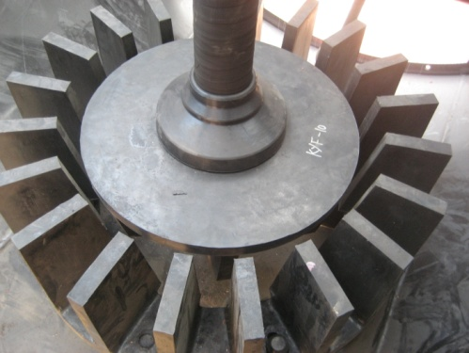
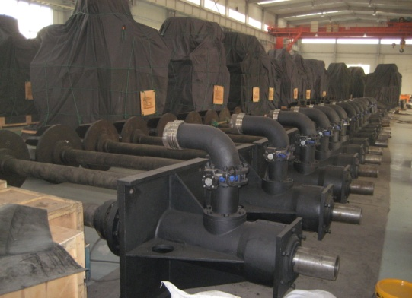
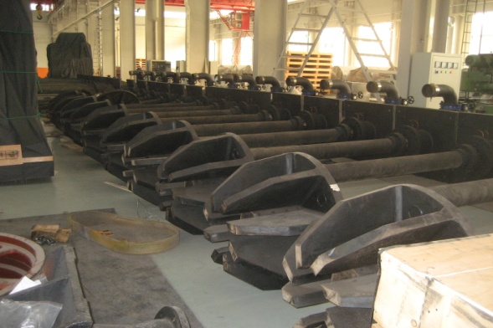
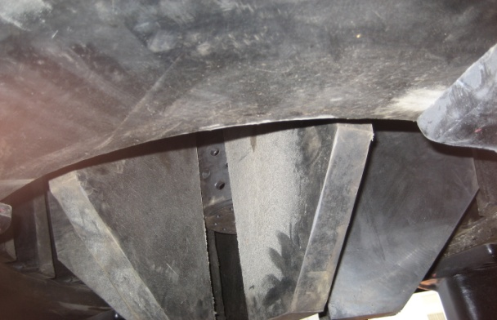
2Mtpa production of a Copper-Gold Sulphide Concentrate 25% copper with 15 to 20g/t gold achievable
Earlier Start-up
Lower capital costs
China-sourced equipment and technology
Faster track to Production and Cash Flow
Construction time will be greatly reduced.
The capital cost may be much lower and more ‘bankable’, at least in China.
Standard equipment should be deliverable with lead-times within the desired mine plan timetable of production in 2015.
Flotation Cell Components

Slide 58
Assessment of capital cost items for the Copper Hill project.
Cost savings realised by sourcing much of the crushing-grinding-flotation-filter equipment from China may be 30% to 40% lower than from other countries.
GCR will proceed down the ‘standard’ route of producing a copper-gold concentrate for sale to smelters.
Metallurgical considerations are always important but for Copper Hill are now critical as GCR examines ways to extract the last additional gold held in the pyritic tails. Test-work completed at Metcon & ALS Burnie.
Copper Hill sulphides floating at Metcon Laboratories

Slide 59
A staged development approach had potential to fast-track Copper Hill towards production
Rationale and benefits
Higher head grades at initial 10Mt pit
Lower initial capital cost
Reduced water and power requirements
Less complex regulatory approval process
Capital cost estimate completed by Calder Maloney Project Services
Metallurgical tests continuing in Sydney (Metcon Laboratories) and ALS Burnie
Notes:
Faster track to production with higher head grades at initial 10Mt pit ( I will introduce more in the next few slides) at lower initial capital cost
Calder Projects Services (CPS) is an Australian owned international consultancy providing Project Management expertise in the fields of Metallurgical plant development and infrastructure associated with mining projects.
Founded in 1991 by Jim Calder, Calder Projects Services has provided services for 18 years to many of the well known Australian and International Engineering Consultants and Project Owners including Bluescope Steel, Egis/CMPS&F, Minproc Engineers, Fluor Daniel, Australian Magnesium Corporation, Ivanhoe Mines, Welded Tube Company of America, Citi Gold, Sinogold, Pasminco, Comalco, Conquest and Ausenco
Core samples from the last round of metallurgical drilling are undergoing testing at Metcon Laboratories in Sydney.
No definitive results have yet been obtained but recoveries, at this early stage, remain low. It is anticipated that the iterative process of testing will, in time, yield higher recoveries, more typical of normal porphyry copper recovery levels.

Slide 60
2012 -Copper Hill
Total Geological Resource:
215 million tonnes at 0.3% copper and 0.24 g/t gold
Constrained Resource:
155 million tonnes at
0.33% copper and 0.28 g/t gold
containing 493,000 tonnes of copper and 1.33 million ounces of gold

Slide 61
Copper Hill
2 million tonnes per annum mill throughput was under consideration
New plant capital costs ($92 million)
Total project notional cost ~$150 million
Faster time-line to production
Reduced water & power requirements
Less complex approval process

Slide 62
Production Strategy Scenario
Stage 1
10 Mt ore at 0.49% copper and 0.55g/t gold
to produce
36,500 tonnes copper and 79,100 ounces gold in concentrate.
2 million tonnes per annum to mill,
manageable capex, early cash flow generated
but ……
minimal annual metal production -
say 7,500 tonnes copper and 20,000 ounces of gold in concentrate.

Slide 63
Copper Hill 10 million tonne Stage 1 ‘Starter Pit’. View from the south-east

Slide 64
Production Strategy Stages 2 & 3 (Mill expansion capacity would be built into initial design)
Stage 2
9.7 Mt ore at 0.40% copper and 0.40 g/t gold
to produce
29,200 tonnes copper and 55,900 ounces gold in concentrate.
Stage 3
10.6 Mt ore at 0.32% copper and 0.32g/t gold
26,100 tonnes copper and 49,300 ounces gold in concentrate.

Slide 65
Copper Hill 30 million tonne pit
3D Site Layout Plan – View from the south-east

Slide 66
Production Strategy Stage 4 Perhaps by now expanded to 6 – 8 Mtpa capacity
Stage 4
72.8 Mt ore at 0.24% copper and 0.23g/t gold
to produce
132,400t tonnes copper and 245,300 ounces gold in concentrate.
…contingent on sustained copper & gold prices above current spot…

Slide 67
Copper Hill
2 million tonnes per annum mill throughput, expanding to 6 Mtpa, was under consideration
Initial plant capital costs ~$92 million
Total project notional cost ~$150 million
……but……
economic returns would not clear the bankability hurdles

Slide 68
2013 - Current Investigations
Copper and gold recoveries of 83% and 70% respectively, have been achieved in recent locked-cycle tests to produce a copper concentrate containing 24% copper and 24g/t gold. There are indications that further improvements may be possible.
GCR examined the economics of a range of throughput options from 5 to 15 Mtpa. 8Mtpa is optimum.
Project is still marginal so it’s back to exploration to add tonnes and improve grades……

Slide 69
Copper Hill – current status
Low grade porphyry copper-gold deposit
Potential to extend and improve the resource base with additional drilling.
Target zones have been identified at Northeast Copper Hill, the Power Anomaly, Hayshed and Vale Head. Further work is also required at Larras Lee, 5 kilometres to the north of Copper Hill.
Studies have indicated that 8 million tonnes per annum mine & mill throughput is the optimum production rate.
Capital costs of over $400 million are estimated.
Financial models indicate that positive cash flows can be generated but not at rates, or with a mine life, sufficient to attract bank finance from conventional sources.
New processing technology under review with samples being tested in Beijing with a view to substantially lower capital costs

Slide 70
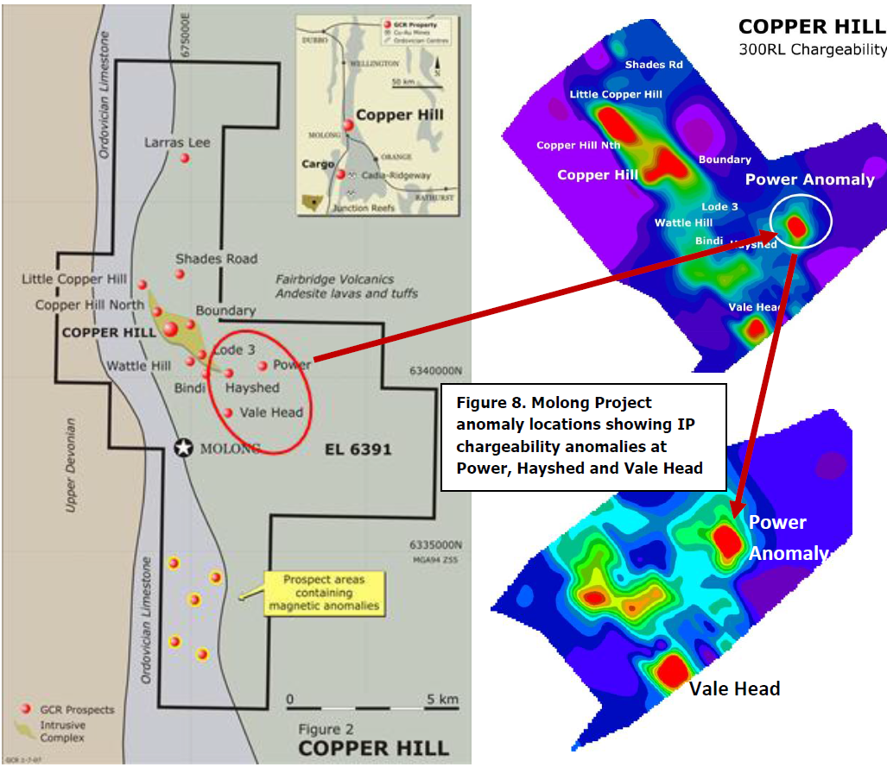

Slide 71
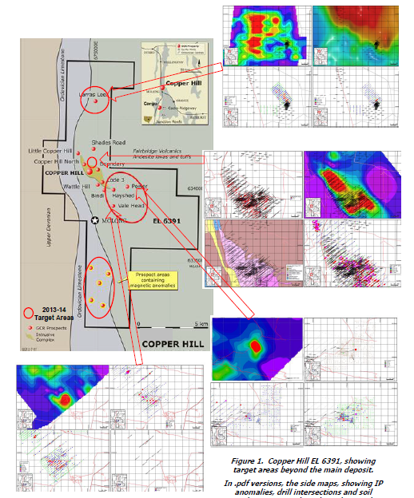
Copper Hill
Exploration near-surface target areas
2013-2014.
The deeper targets will have to wait

Slide 72
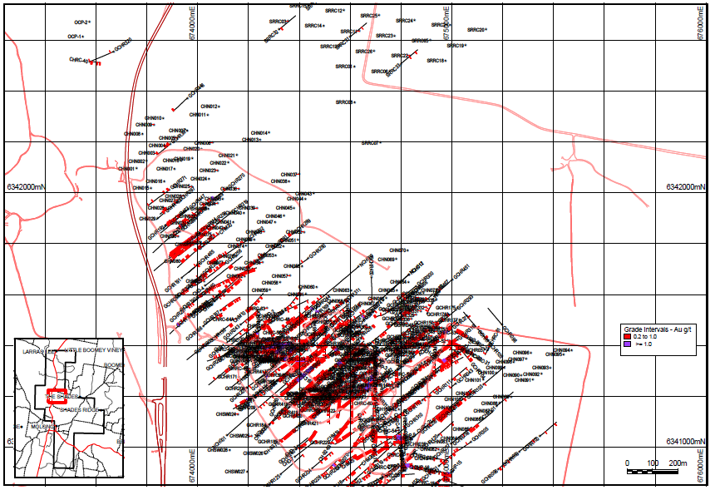
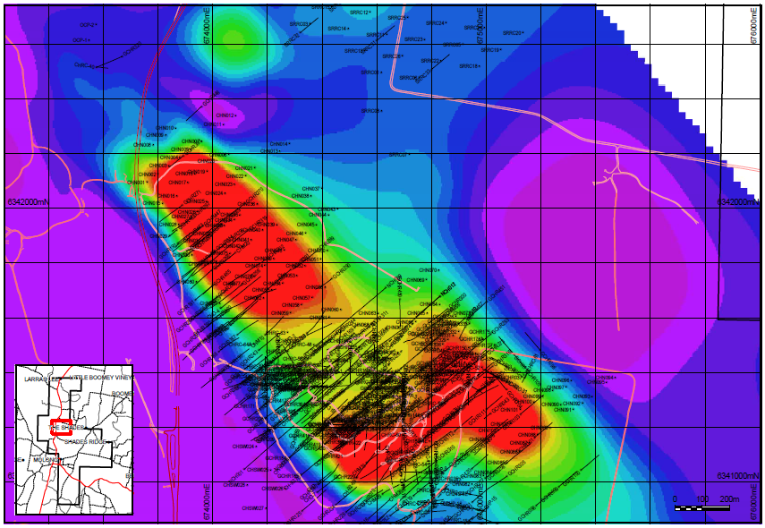
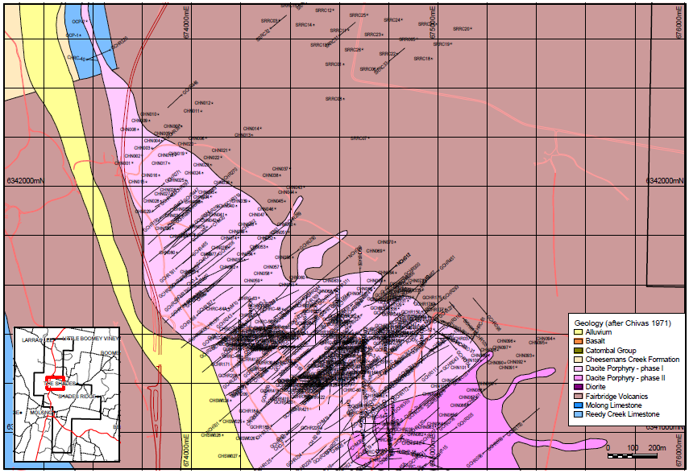
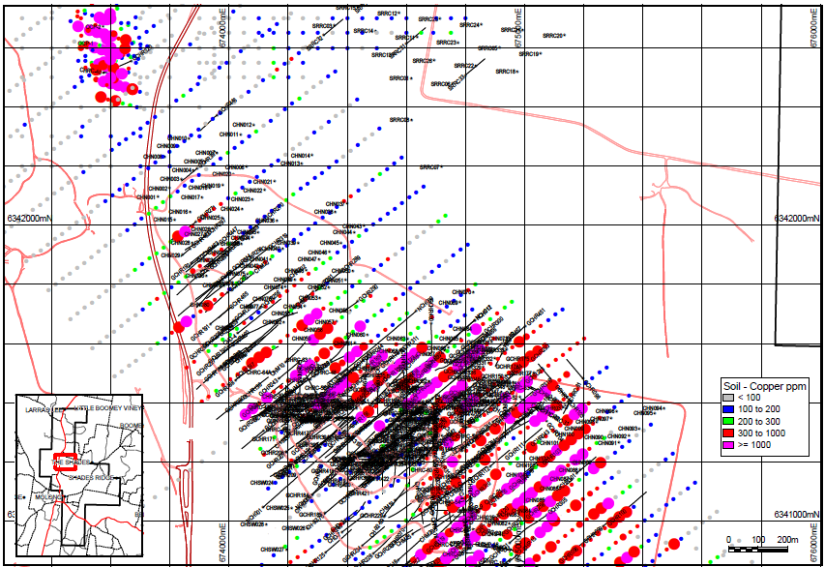
North-east Copper Hill. IP ‘shoulder’ and the ‘Untested Zone’

Slide 73
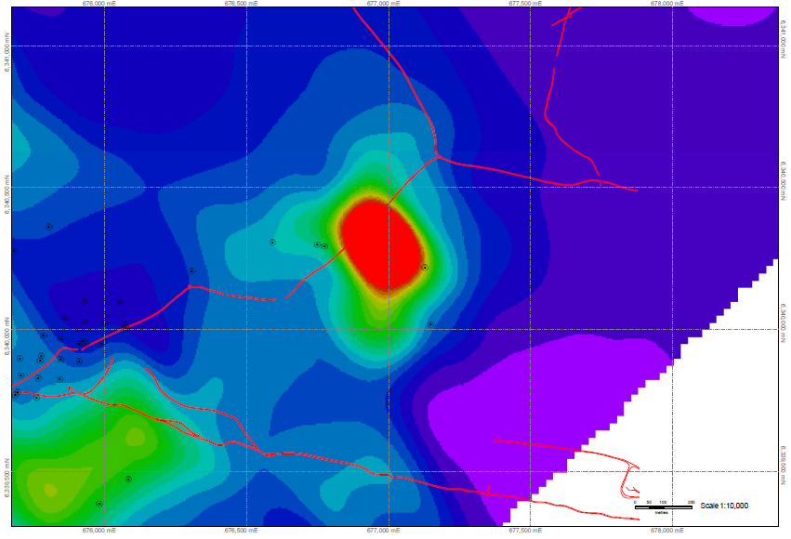
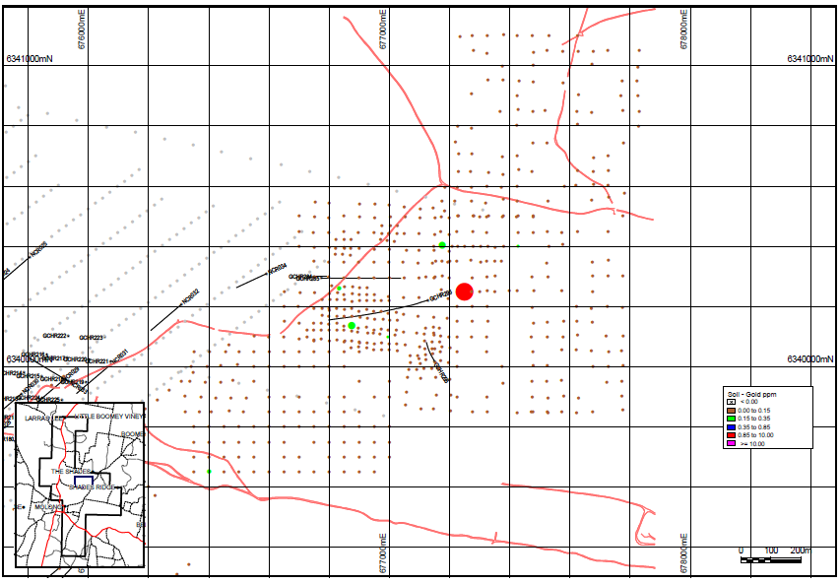
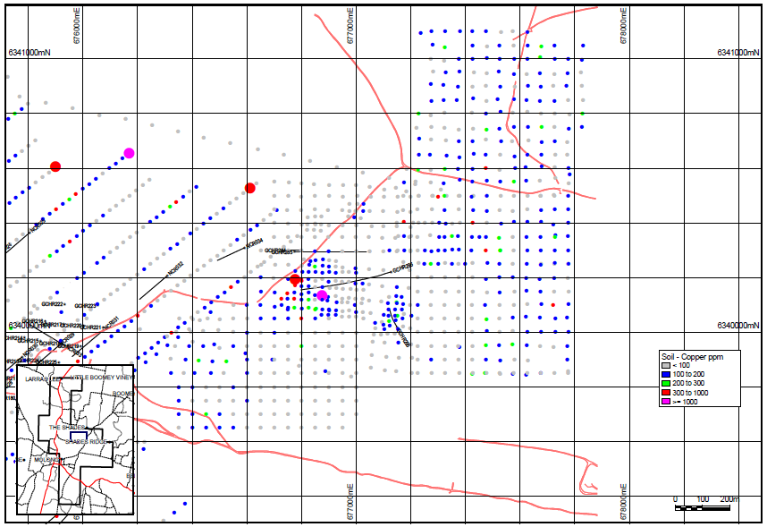
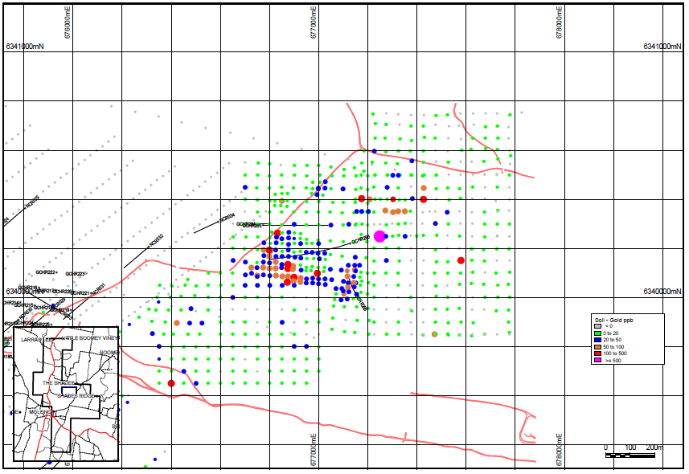
Power Anomaly – IP, soil geochemistry and drill holes

Slide 74
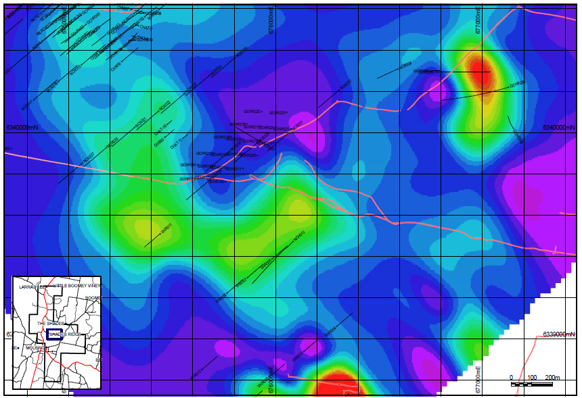
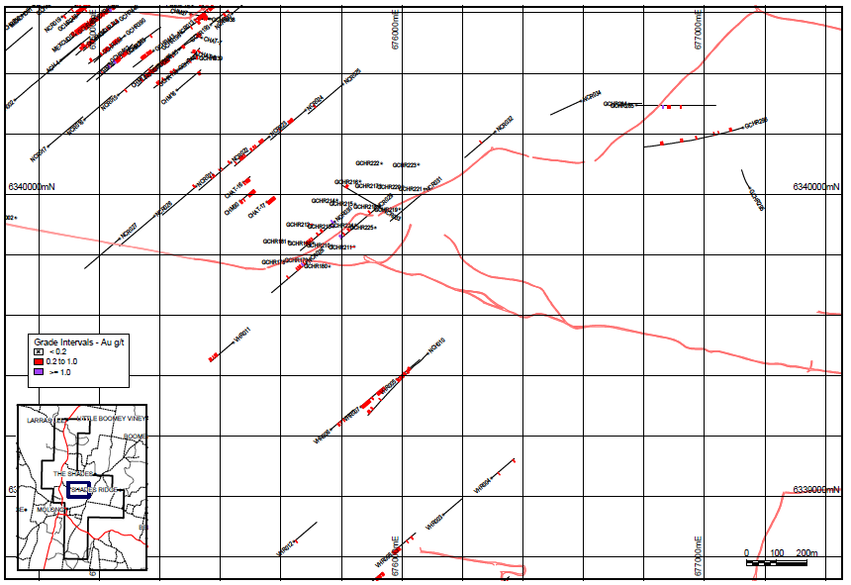
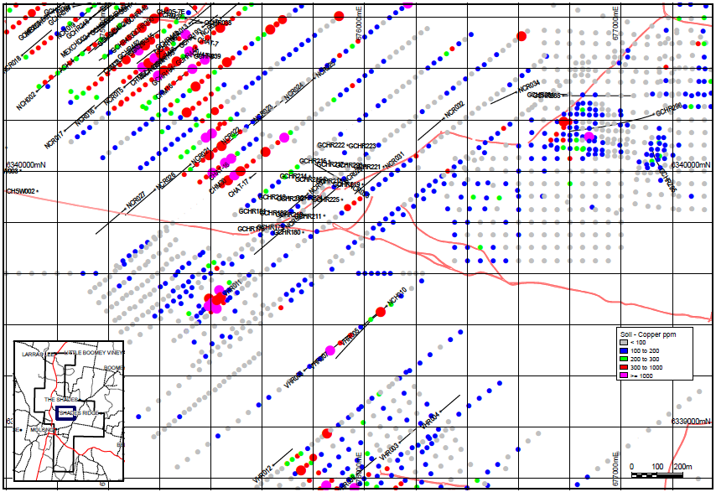
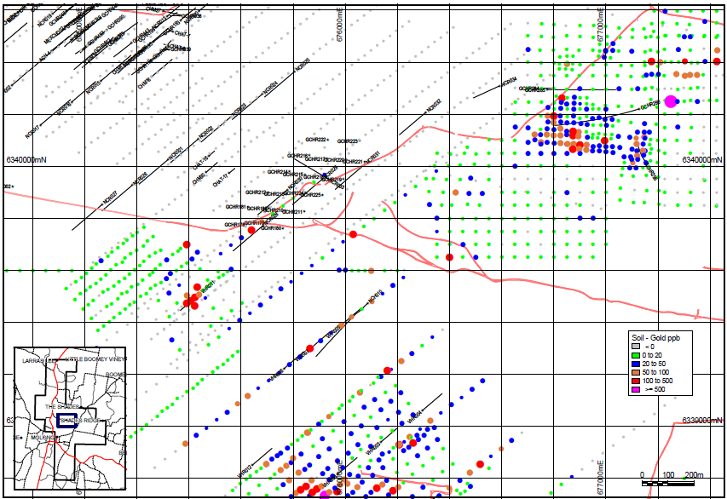
Hayshed prospect. IP, drill holes and soil geochemistry

Slide 75
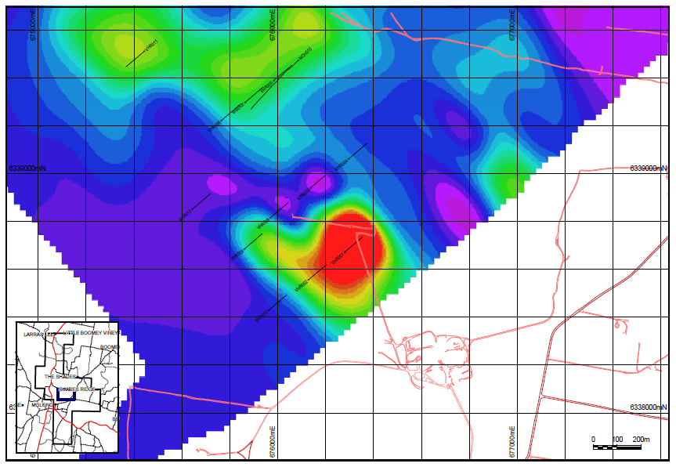
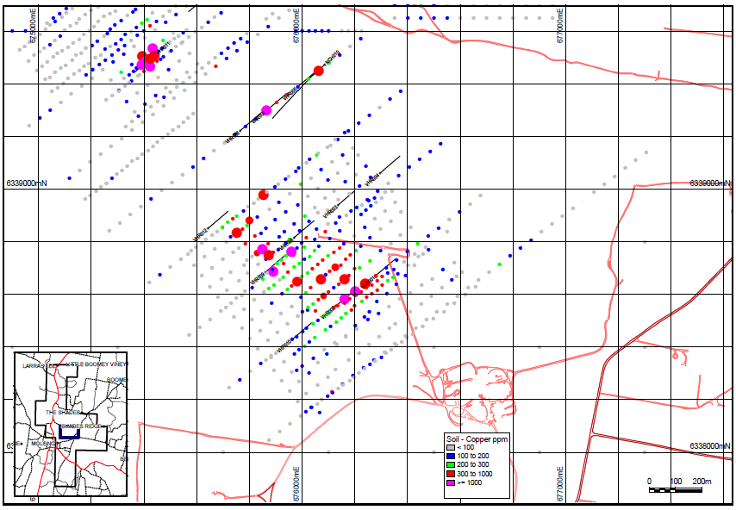
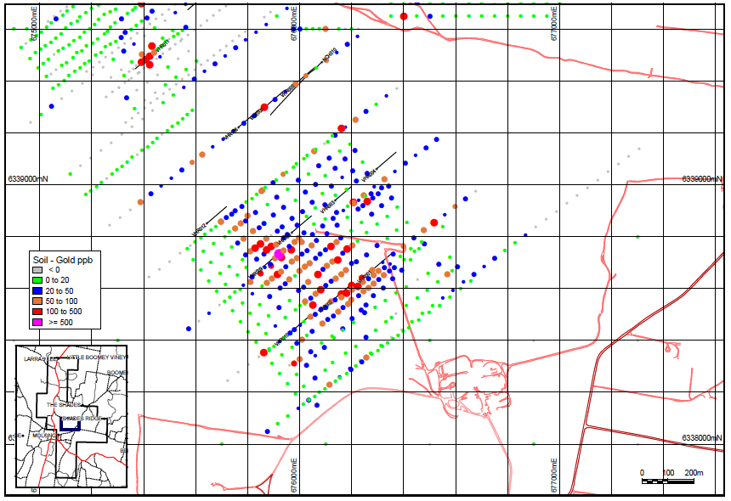
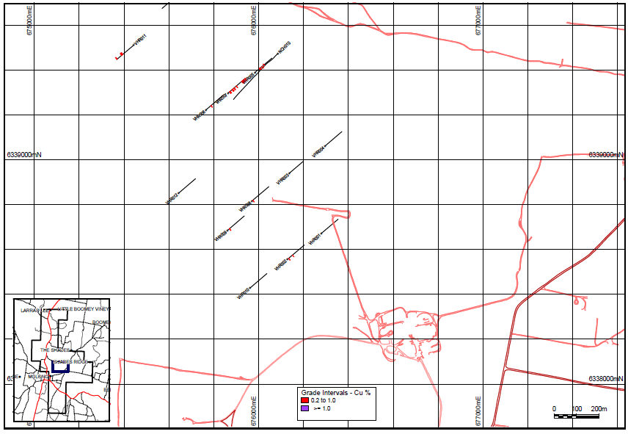
Vale Head Prospect. IP, copper and gold soil geochemistry and drill holes

Slide 76
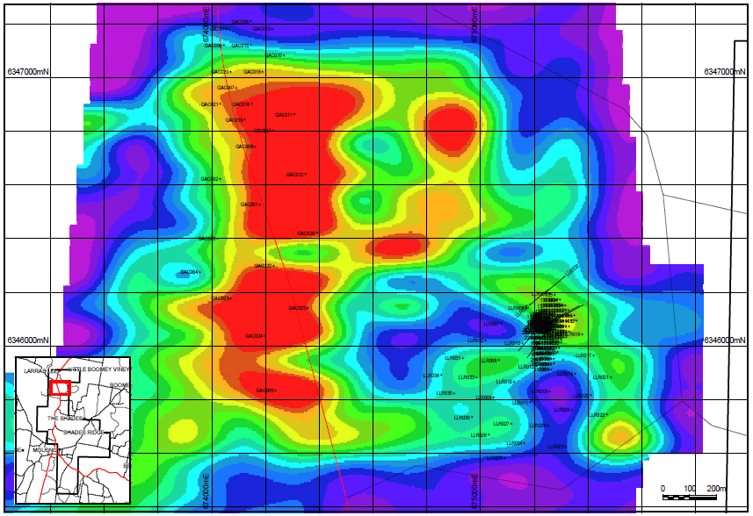
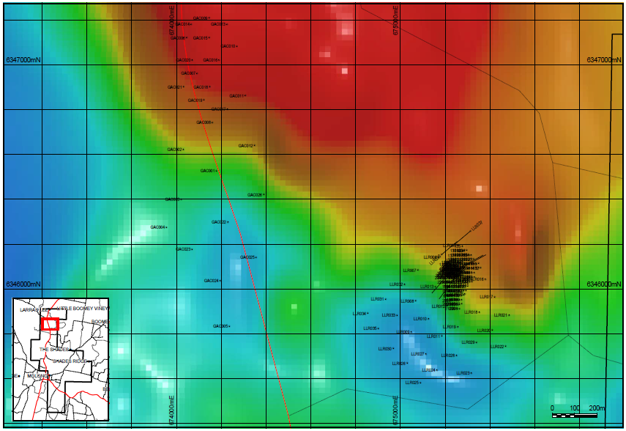
Soils - gold ppb
Larras Lee. IP, magnetics, copper and gold soil geochemistry

Slide 77
The seriously deranged may wish to stay on to see detailed financial models, petrographic descriptions and the struggles with metallurgy but I recommend heading for the core display and a wander up to the old ‘open pit’.
Thank you.

